Slide 1


Simulated Assembly Line and
Processing Workstation
Team 520

Slide 2





Team Introductions
Cheyenne Laurel
Project Manager
David DiMaggio
Design Engineer
Boluwatife Olabiran
Software Engineer
JoEll Williams
Hardware Engineer
Nataajah Taylor
Test Engineer

Slide 3



Sponsor and Advisor
TCC Representative
Bobette Stubblefield
TCC Representative
Dylan Sutton
Team Advisor
Dr. Dorr Campbell
Cheyenne Laurel

Slide 4
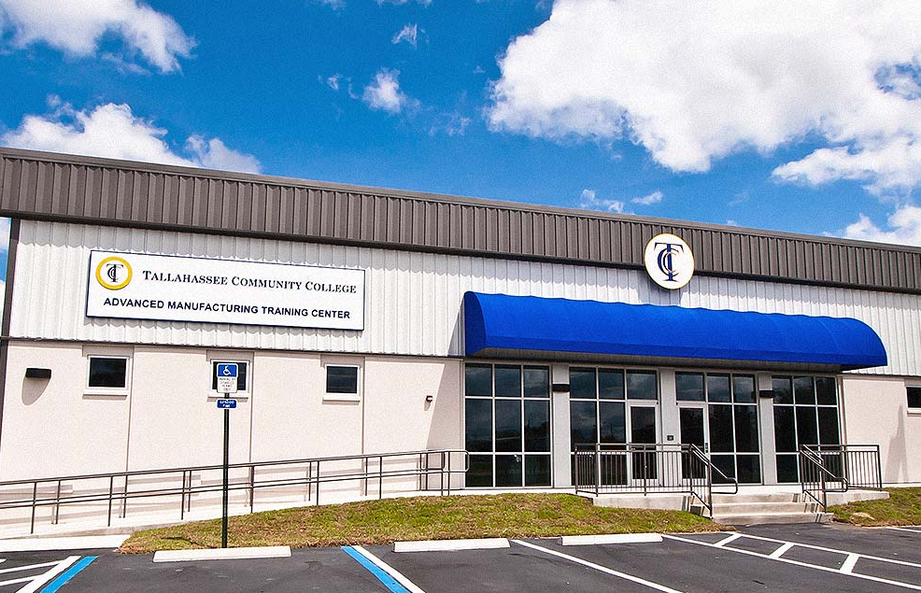
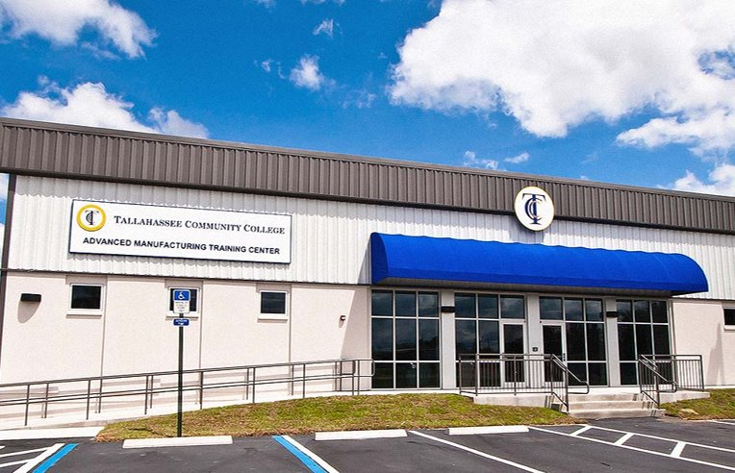

Objective
Tallahassee Community College (TCC) requires an assembly line system to be used in their Advanced Manufacturing and Training Center as an educational tool.
Will be used as a Mechatronics certification tool.
Must allow for user to toggle failures in the hardware and software to allow for student diagnosis and repair.
Figure 1: Advanced Manufacturing and Training Center at TCC

Slide 5
Project Background
Cheyenne Laurel

Slide 6
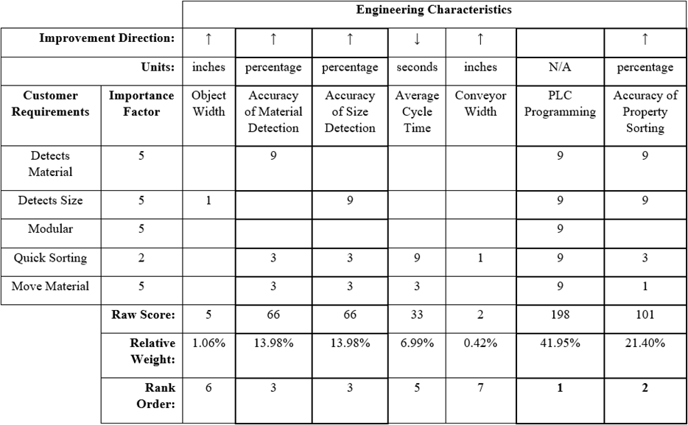
House of Quality
Determined the most important engineering characteristics to be:
PLC Programming
Accuracy of Physical Property Sorting
Accuracy of Material Detection
Accuracy of Size Detection
Table 1: House of Quality

Slide 7
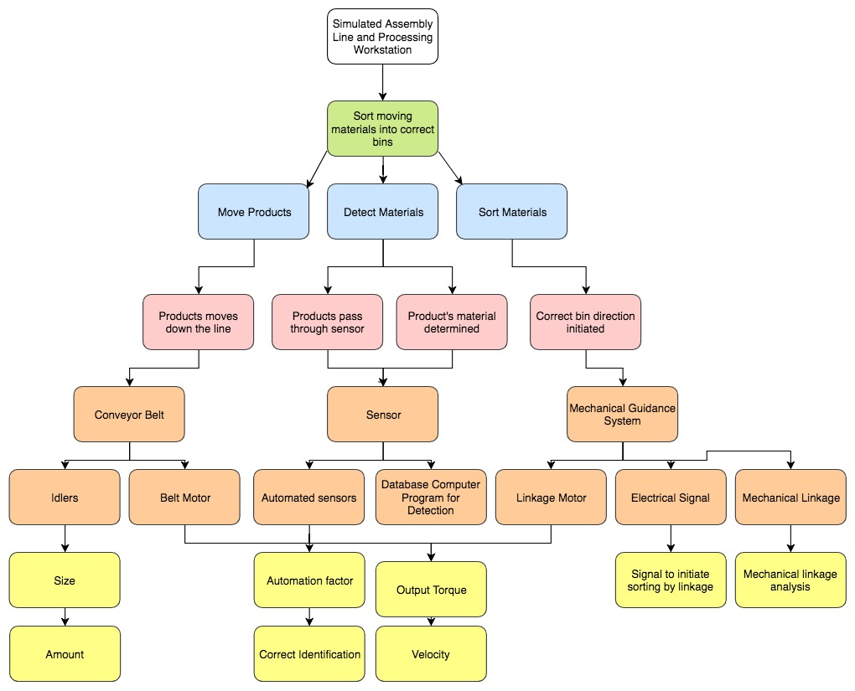
Functional Decomposition
Green- Overall Function Goal
Blue- 3 Main Functions to be achieved
Pink- Secondary Functions
Orange- Physical Components
Yellow- Measurable Inputs and Outputs
Figure 2: Functional Decomposition

Slide 8
Concept Generation
Boluwatife Olabiran

Slide 9
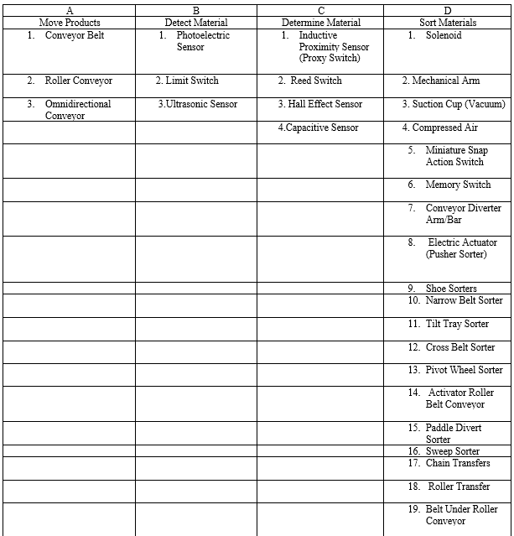
Morphological Chart
Highlights concept per function.
Total of 617 possible concepts.
Narrowed down to 8 designs for Concept Selection.
Table 2: Concept Generation Chart

Slide 10
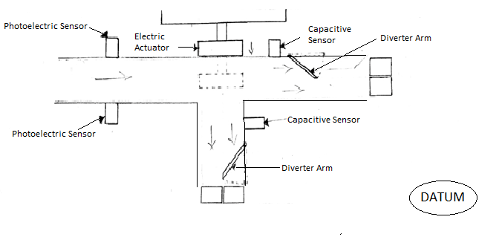
Datum Concept
Photoelectric sensor
Electric Actuator
2 Diverter Arms
2 Capacitive sensors
  Actuator pushes object to second conveyor belt based on size.
Figure 3: Datum Concept

Slide 11
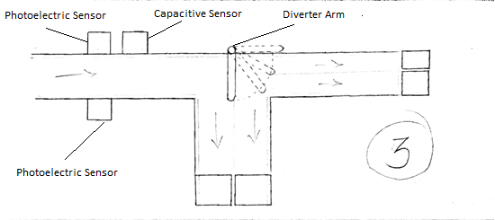
Concept 3
2 Photoelectric Sensor
1 Capacitive Sensor
1 Diverter Arm
2 Conveyor Belts
  Diverter arm programmed at angles to guide objects in corresponding bins.
Concept 3

Slide 12
Concept Selection
Boluwatife Olabiran

Slide 13
Pugh Chart
Table 3: Pugh Chart

Slide 14
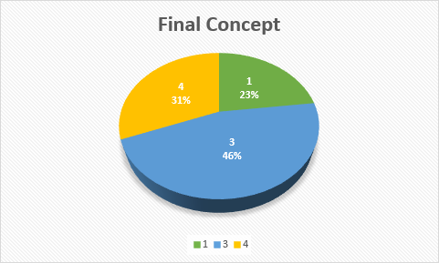
Final Ratings Matrix
Selection Criteria | Accuracy of Property Sorting | Accuracy of Material Detection | Accuracy of Size Detection | Average Cycle Time | Cost | Complexity of Programming | Fixability | Machinability | Ease of Modularity
Concept 1 | 0.30 | 0.19 | 0.28 | 0.19 | 0.08 | 0.10 | 0.25 | 0.25 | 0.33
Concept 3 | 0.37 | 0.08 | 0.64 | 0.75 | 0.72 | 0.69 | 0.66 | 0.66 | 0.33
Concept 4 | 0.33 | 0.72 | 0.07 | 0.75 | 0.19 | 0.21 | 0.09 | 0.09 | 0.33
Table 4: Final Rating Matrix

Slide 15
Embodiment
Nataajah Taylor

Slide 16
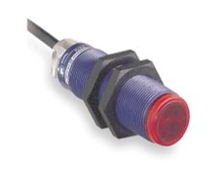
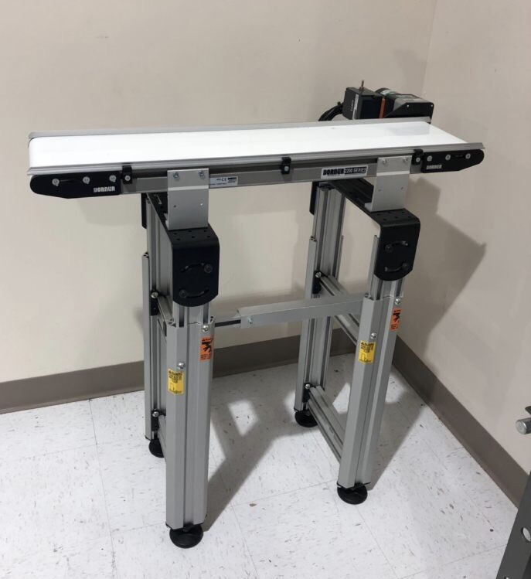
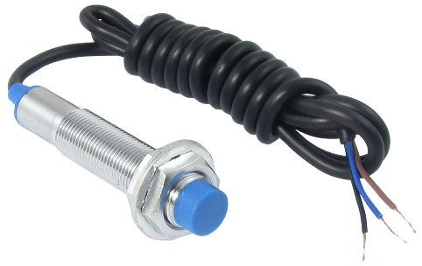
Manufacturing Technology
Dorner 2200 Conveyor Belt:
Small Part Handling and Positioning
Photoelectric Sensors:
Uses a light transmitter and receiver to test if object is in sensing area, as well as detecting size
Inductive Sensor:
Detects metal using magnetic fields when the object touches the sensor
Figure 8: Photoelectric Sensor
Figure 7: Dorner 2200 Conveyor Belt
Figure 9: Inductive Proximity sensor
Nataajah Taylor

Slide 17
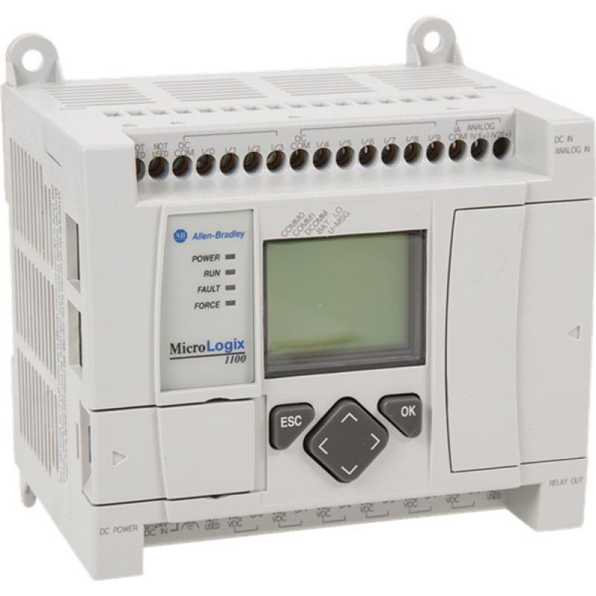
PLC Technology
Allen-Bradley MicroLogix 1100:
  2 analog inputs, 10 digital inputs and 6 digital outputs
  Solid State Memory
  Ethernet Connection Port
PLC’s contain necessary relays, timers, coils and other components that would be required for a relay logic system.
PLC’s are also ruggedized to withstand temperature ranges, electrical noises, vibrations, and impacts.
Figure 10: Allen-Bradley MicroLogix 1100 PLC
Nataajah Taylor

Slide 18
Failure Modes and Effects Analysis
Allows for the anticipation of failures in a design or manufacturing process.
Requires each component to have three different failure ratings (1-10):
  Severity – How hazardous is the failure? How much will it disrupt the process?
  Occurrence – How often is the part likely to fail?
  Detection – How likely is the system able to detect the failure?
Risk Priority Number (RPN)= $Severity × Occurrence × Detection$
Nataajah Taylor

Slide 19
Failure Modes and Effects Analysis
Table 6: Failure Modes and Effects Analysis
Nataajah Taylor

Slide 20
Failure Modes and Effects Analysis
Sensors have high RPNs due to their sensitivity to outside factors.
Servo Motor is also susceptible to failure if the voltage supply is incorrect, as well as outside factors like vibrations.
PLC Software/Programming has to be correct in order for system to run.
Table 7: FMEA Summary
Nataajah Taylor

Slide 21
Design and Construction
David DiMaggio

Slide 22
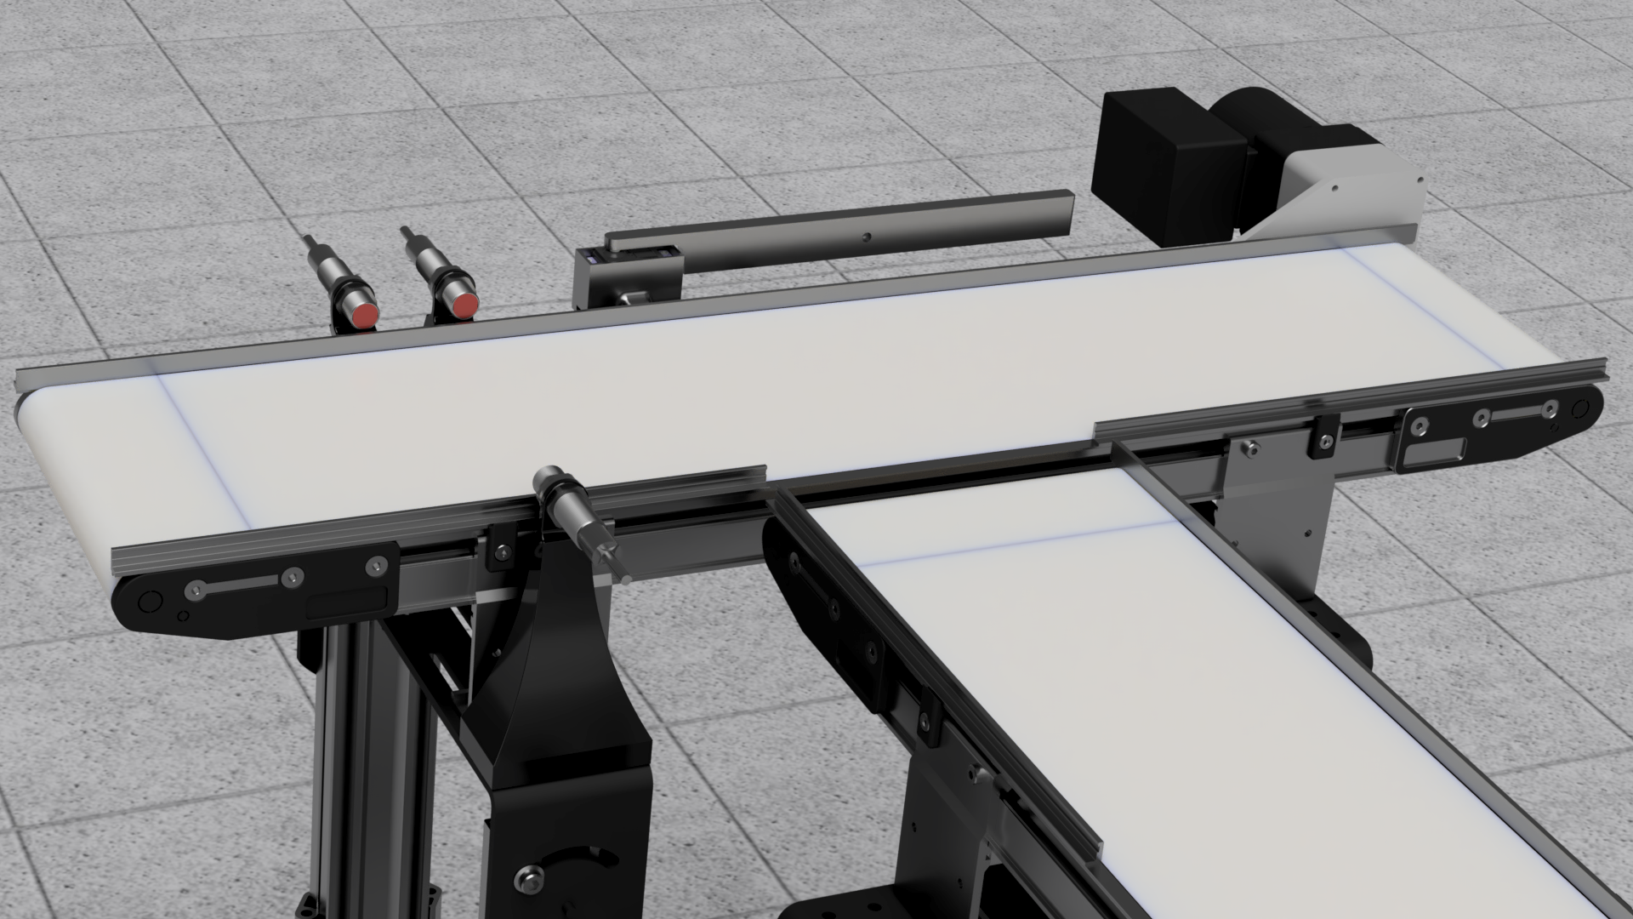
Project Design
Consists of a multiple step process:
Step 1: An object is placed on the conveyor belt.
Step 2: Inductive and Photoelectric sensors detect if object is present, as well as size and material.
Step 3: Diverter arm, attached to a motor, moves the object to correct position for sorting based on received sensor information.
Figure 11: Assembly Line CAD
David DiMaggio

Slide 23
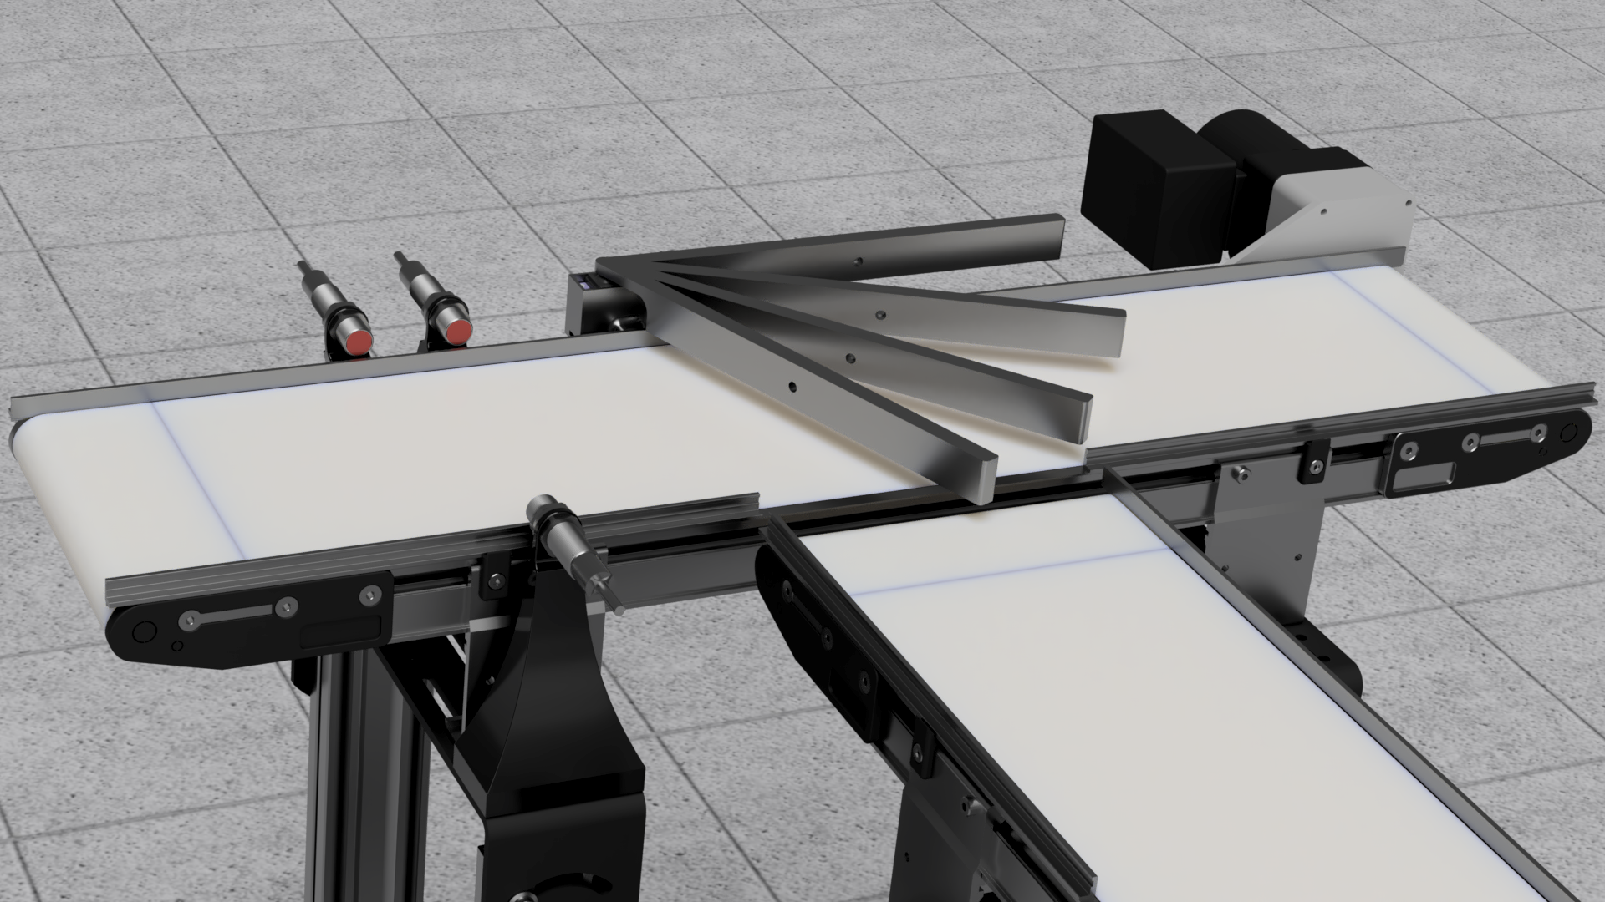
Sorting Angles
① 0° - Big and plastic
② 28° - small and plastic
③ 50°​ - Big and metal
④ 71° - Small and metal
A “big” object will be greater than or equal to 2 inches.
A “small” object will be less than 2 inches
①
②
③
④
Figure 12: Sorting Angles
David DiMaggio

Slide 24
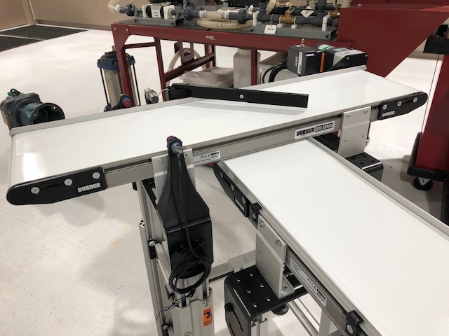
Manufacturing
Sensors, servo motor, and diverter arm are assembled.
Wiring of different components to the PLC is currently in progress.
Testing of each component with the PLC is currently in progress.
Figure 13: Current System Set-Up
David DiMaggio

Slide 25
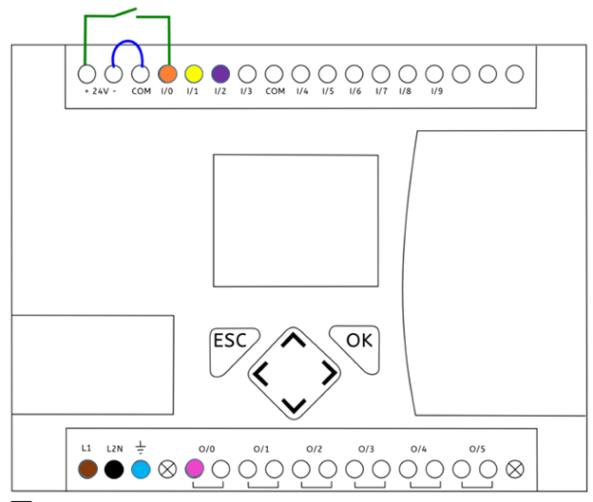
Wiring Diagram
DC Power Supply
Brown – Connection to +24 V terminal
Black – Connection to –24 V terminal
Blue – Grounded to 0 V
Inputs
Orange - Inductive sensor port
Yellow - Photoelectric Switch
Purple – Capacitive Sensor
Output(s)
Red – Servo Motor port
Figure 14: Wiring of Inputs/Outputs for PLC
JoEll Williams

Slide 26
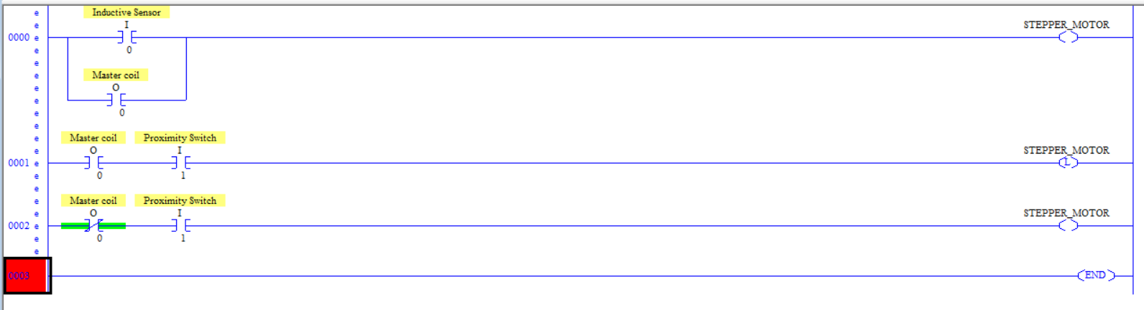
Programming
RUNG 000: The inductive sensor adjusts the stepper motor position
RUNG 001: The Master coil is a variable that use the output as an input
Each RUNG consists of functions and inputs that use the Logic AND to produce an output.
The Servo Motor is the only hardwired output.
Figure 15: PLC Programming
JoEll Williams

Slide 27
Lessons Learned
3D printed parts will never be perfect the first iteration.
PLC Programming is more straight forward than websites make it out to be.
Bureaucracy plays a major factor in project development.
JoEll Williams

Slide 28
Future Work
JoEll Williams

Slide 29
References
CEIA , THS, Metal Detector, 2011, Serial number 20800450034, aperture 550 x 75mm, belt 2750 x 500mm .This items will be. (n.d.). Retrieved from https://www.go-dove.com/en/auction/view?id=13216983
“48mm Retroreflective Cylindrical Photoelectric Sensor; Max. Sensing Distance: 3.0m.” Grainger - For the Ones Who Get It Done., www.grainger.com/product/TELEMECANIQUE-SENSORS-48mm-Retroreflective-Cylindrical- 32J327?searchBar=true&searchQuery=32J327.
“Detection Based on ‘Light‘What Is a Photoelectric Sensor?” Main Types of Microscopes: Types & Principle｜KEYENCE Biological Fluorescence Microscopes, www.keyence.com/ss/products/sensor/sensorbasics/photoelectric/info/.
“100 Hz Capacitive Cylindrical Proximity Sensor with Max. Detecting Distance 8.0mm.” Grainger - For the Ones Who Get It Done., www.grainger.com/product/OMRON-100-Hz-Capacitive-Cylindrical- 2AKD8?searchBar=true&searchQuery=2AKD8.
“1200 Hz Inductive Cylindrical Proximity Sensor with Max. Detecting Distance 8.0mm.” Grainger - For the Ones Who Get It Done., www.grainger.com/product/EATON-1200-Hz-Inductive-Cylindrical- 40HT96?searchBar=true&searchQuery=40HT96.

Slide 30
Questions?

Slide 31
Backup Slides

Slide 32
FMEA Backup

Slide 35
Concept Selection Backup

Slide 36
Morphological Chart

Slide 37
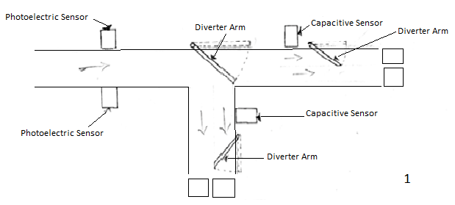
Concept 1
Photoelectric sensor
3 Diverter Arms
3 Stepper Motors
2 Capacitive sensors
  First diverter arm guides object to second conveyor belt based on size.
Figure 4: Concept 1
Bolu Olabiran

Slide 38
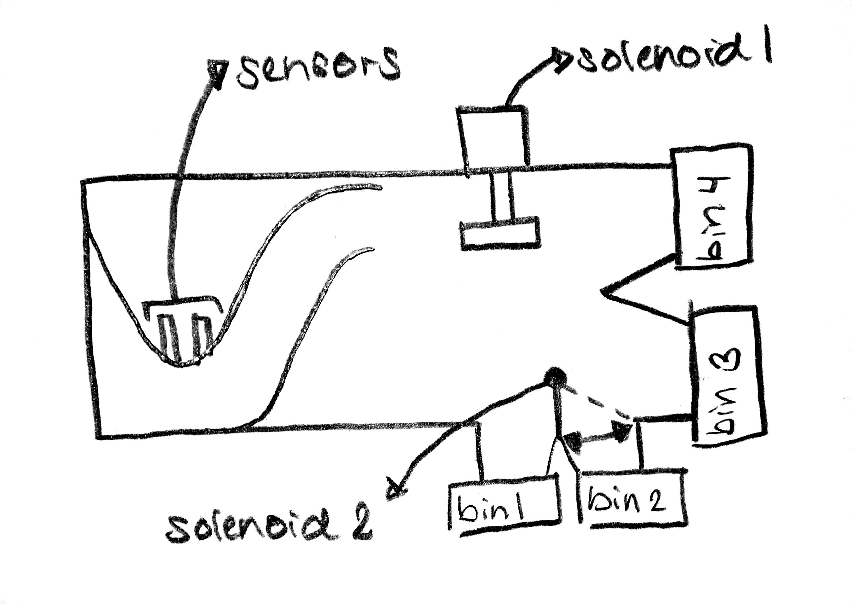
Concept 4
1 Photoelectric Sensor
2 Solenoids
2 Conveyor Belts
Diverter Arm
Track to guide objects near sensors.
  Solenoids are the physical movers.
Figure 6: Concept 4
Bolu Olabiran

Slide 41
Detailed Math Backup

Slide 44
Standard Shapes
Summary Box
Text box 1
Outlined Text Box

Slide 45




Approved Logos

Slide 46
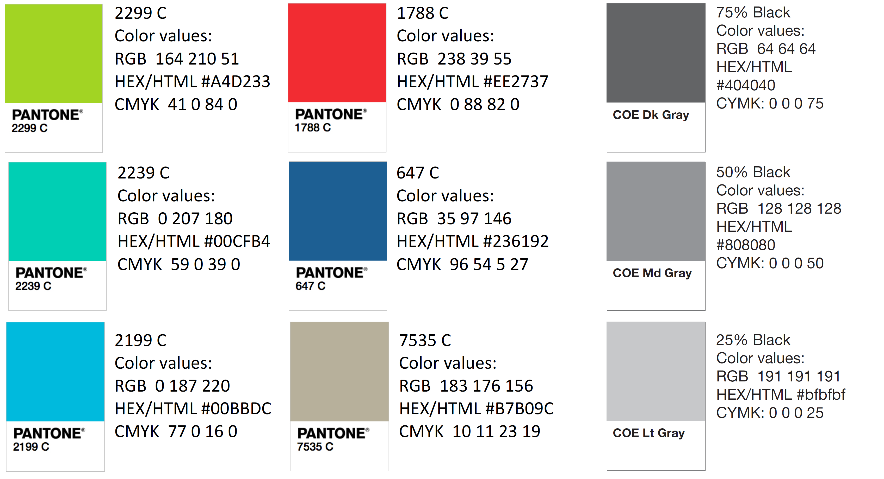
Color Palette

Slide 47
APA Tables
Category 1 | Category 2 | Category 3 | Category 4 | Category 5
Item 1
Item 2
Item 3
Item 4
 | Category 2 |  |  | Category 3
Category 1 | subcategory 1 | subcategory 2 |  | subcategory 1 | subcategory 2
Item 1
Item 2
Item 3
Item 4

